Slide 1
Hindgut composition of Angelfish
Calla Bush St George
Wednesday, May 1st

Slide 2
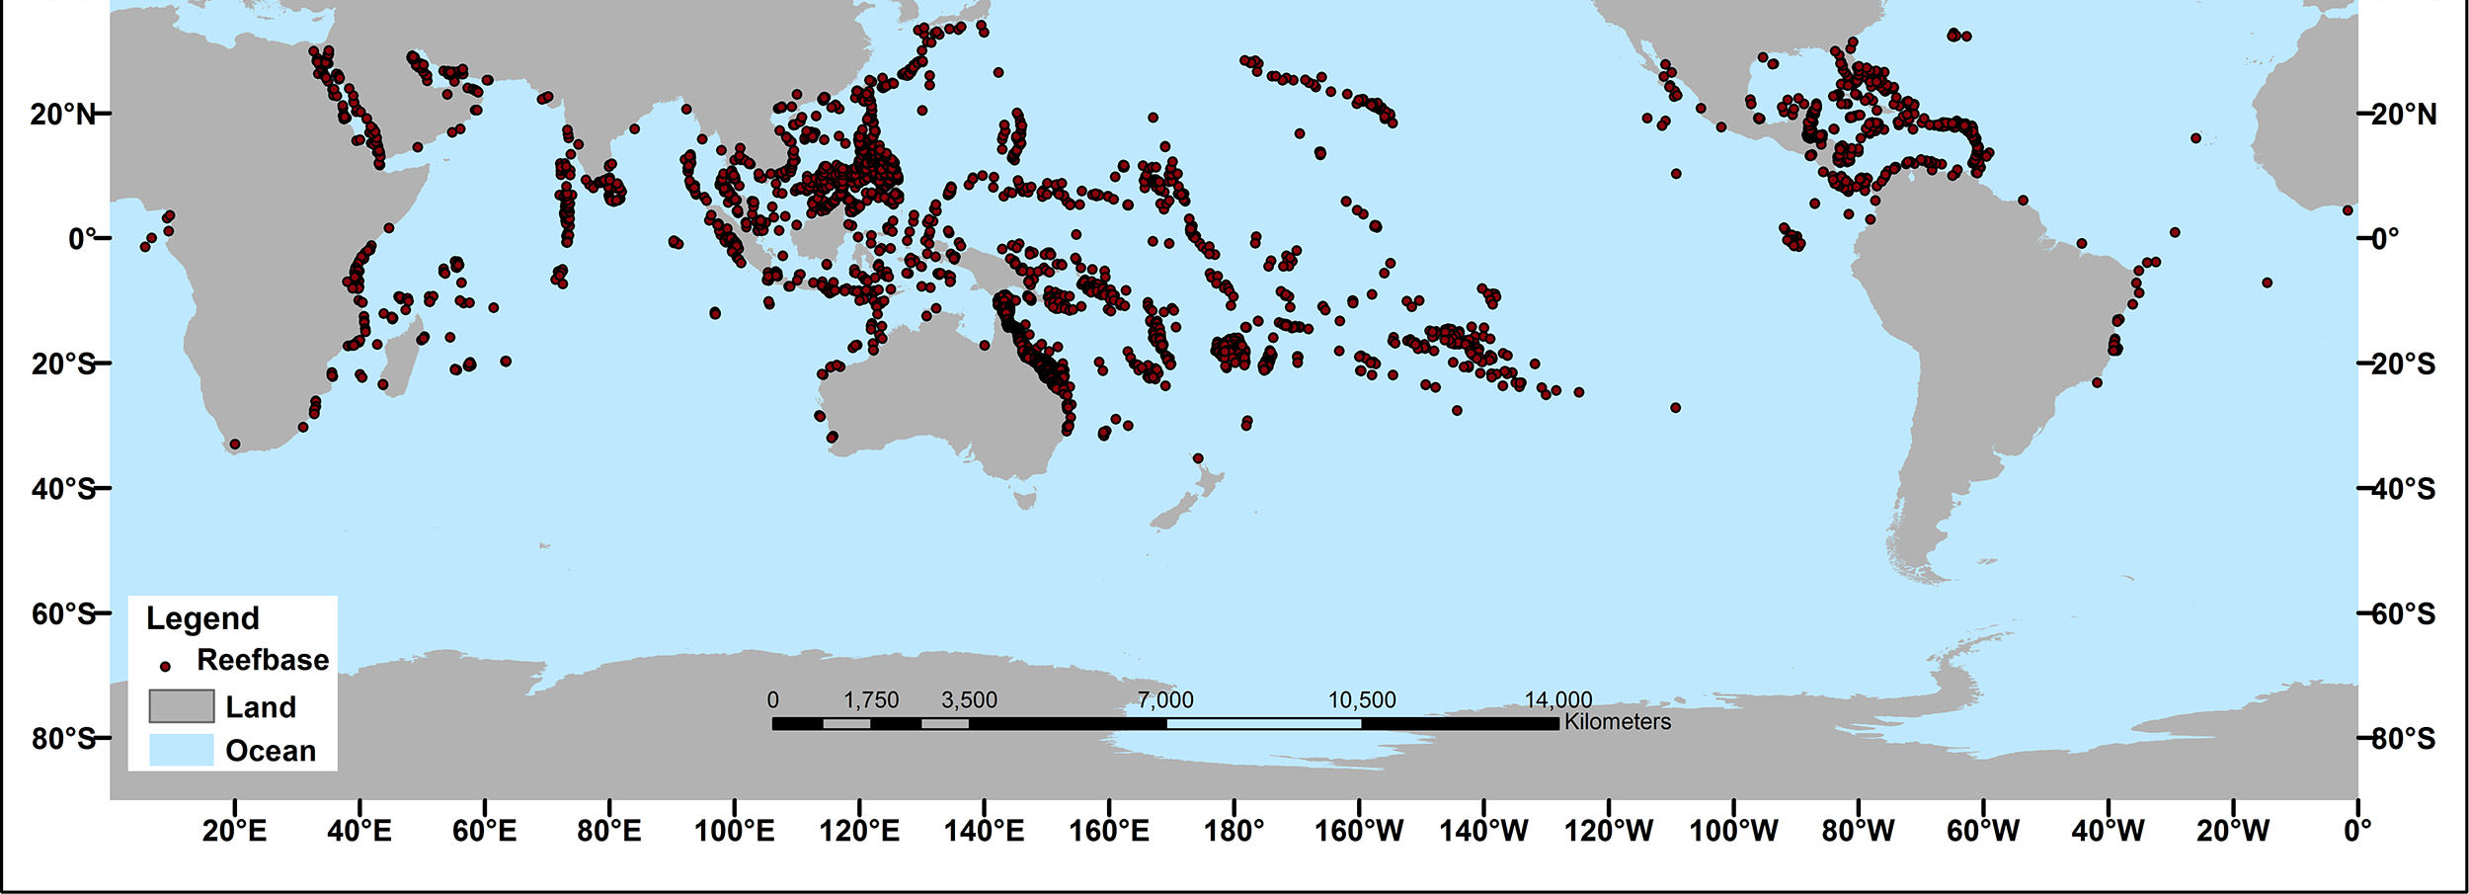
Global distribution of coral reefs
National Oceanic and Atmospheric Organization
25 percent of global life
Over 4000 species of fish
1 billion people worldwide

Slide 3
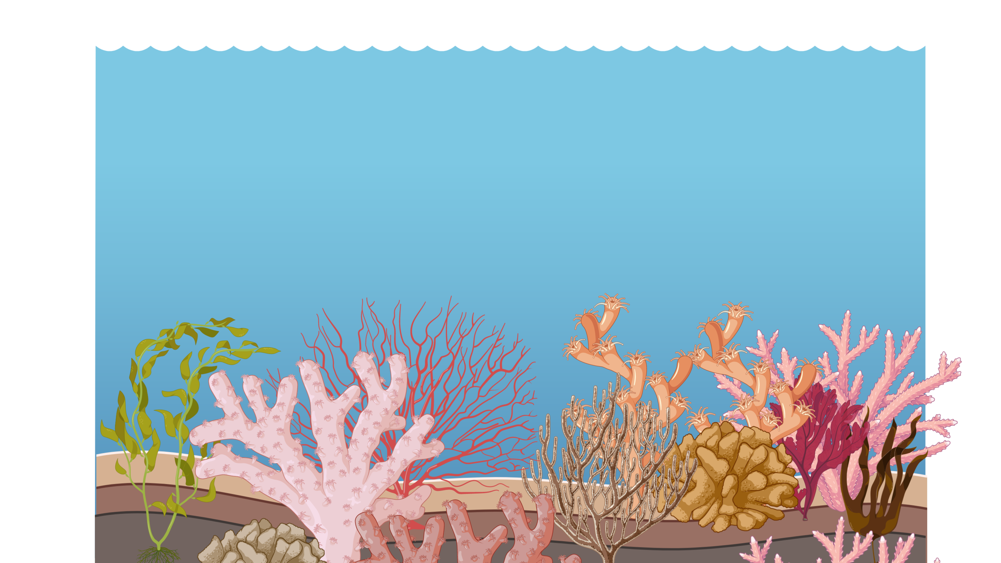
Cartoon from BioRender
Coral reefs are in danger
More CO₂ in the atmosphere increases acidity in the ocean
Global warming increases ocean temperatures
Center of activity for marine life

Slide 4
Warning: fish dissection

Slide 5
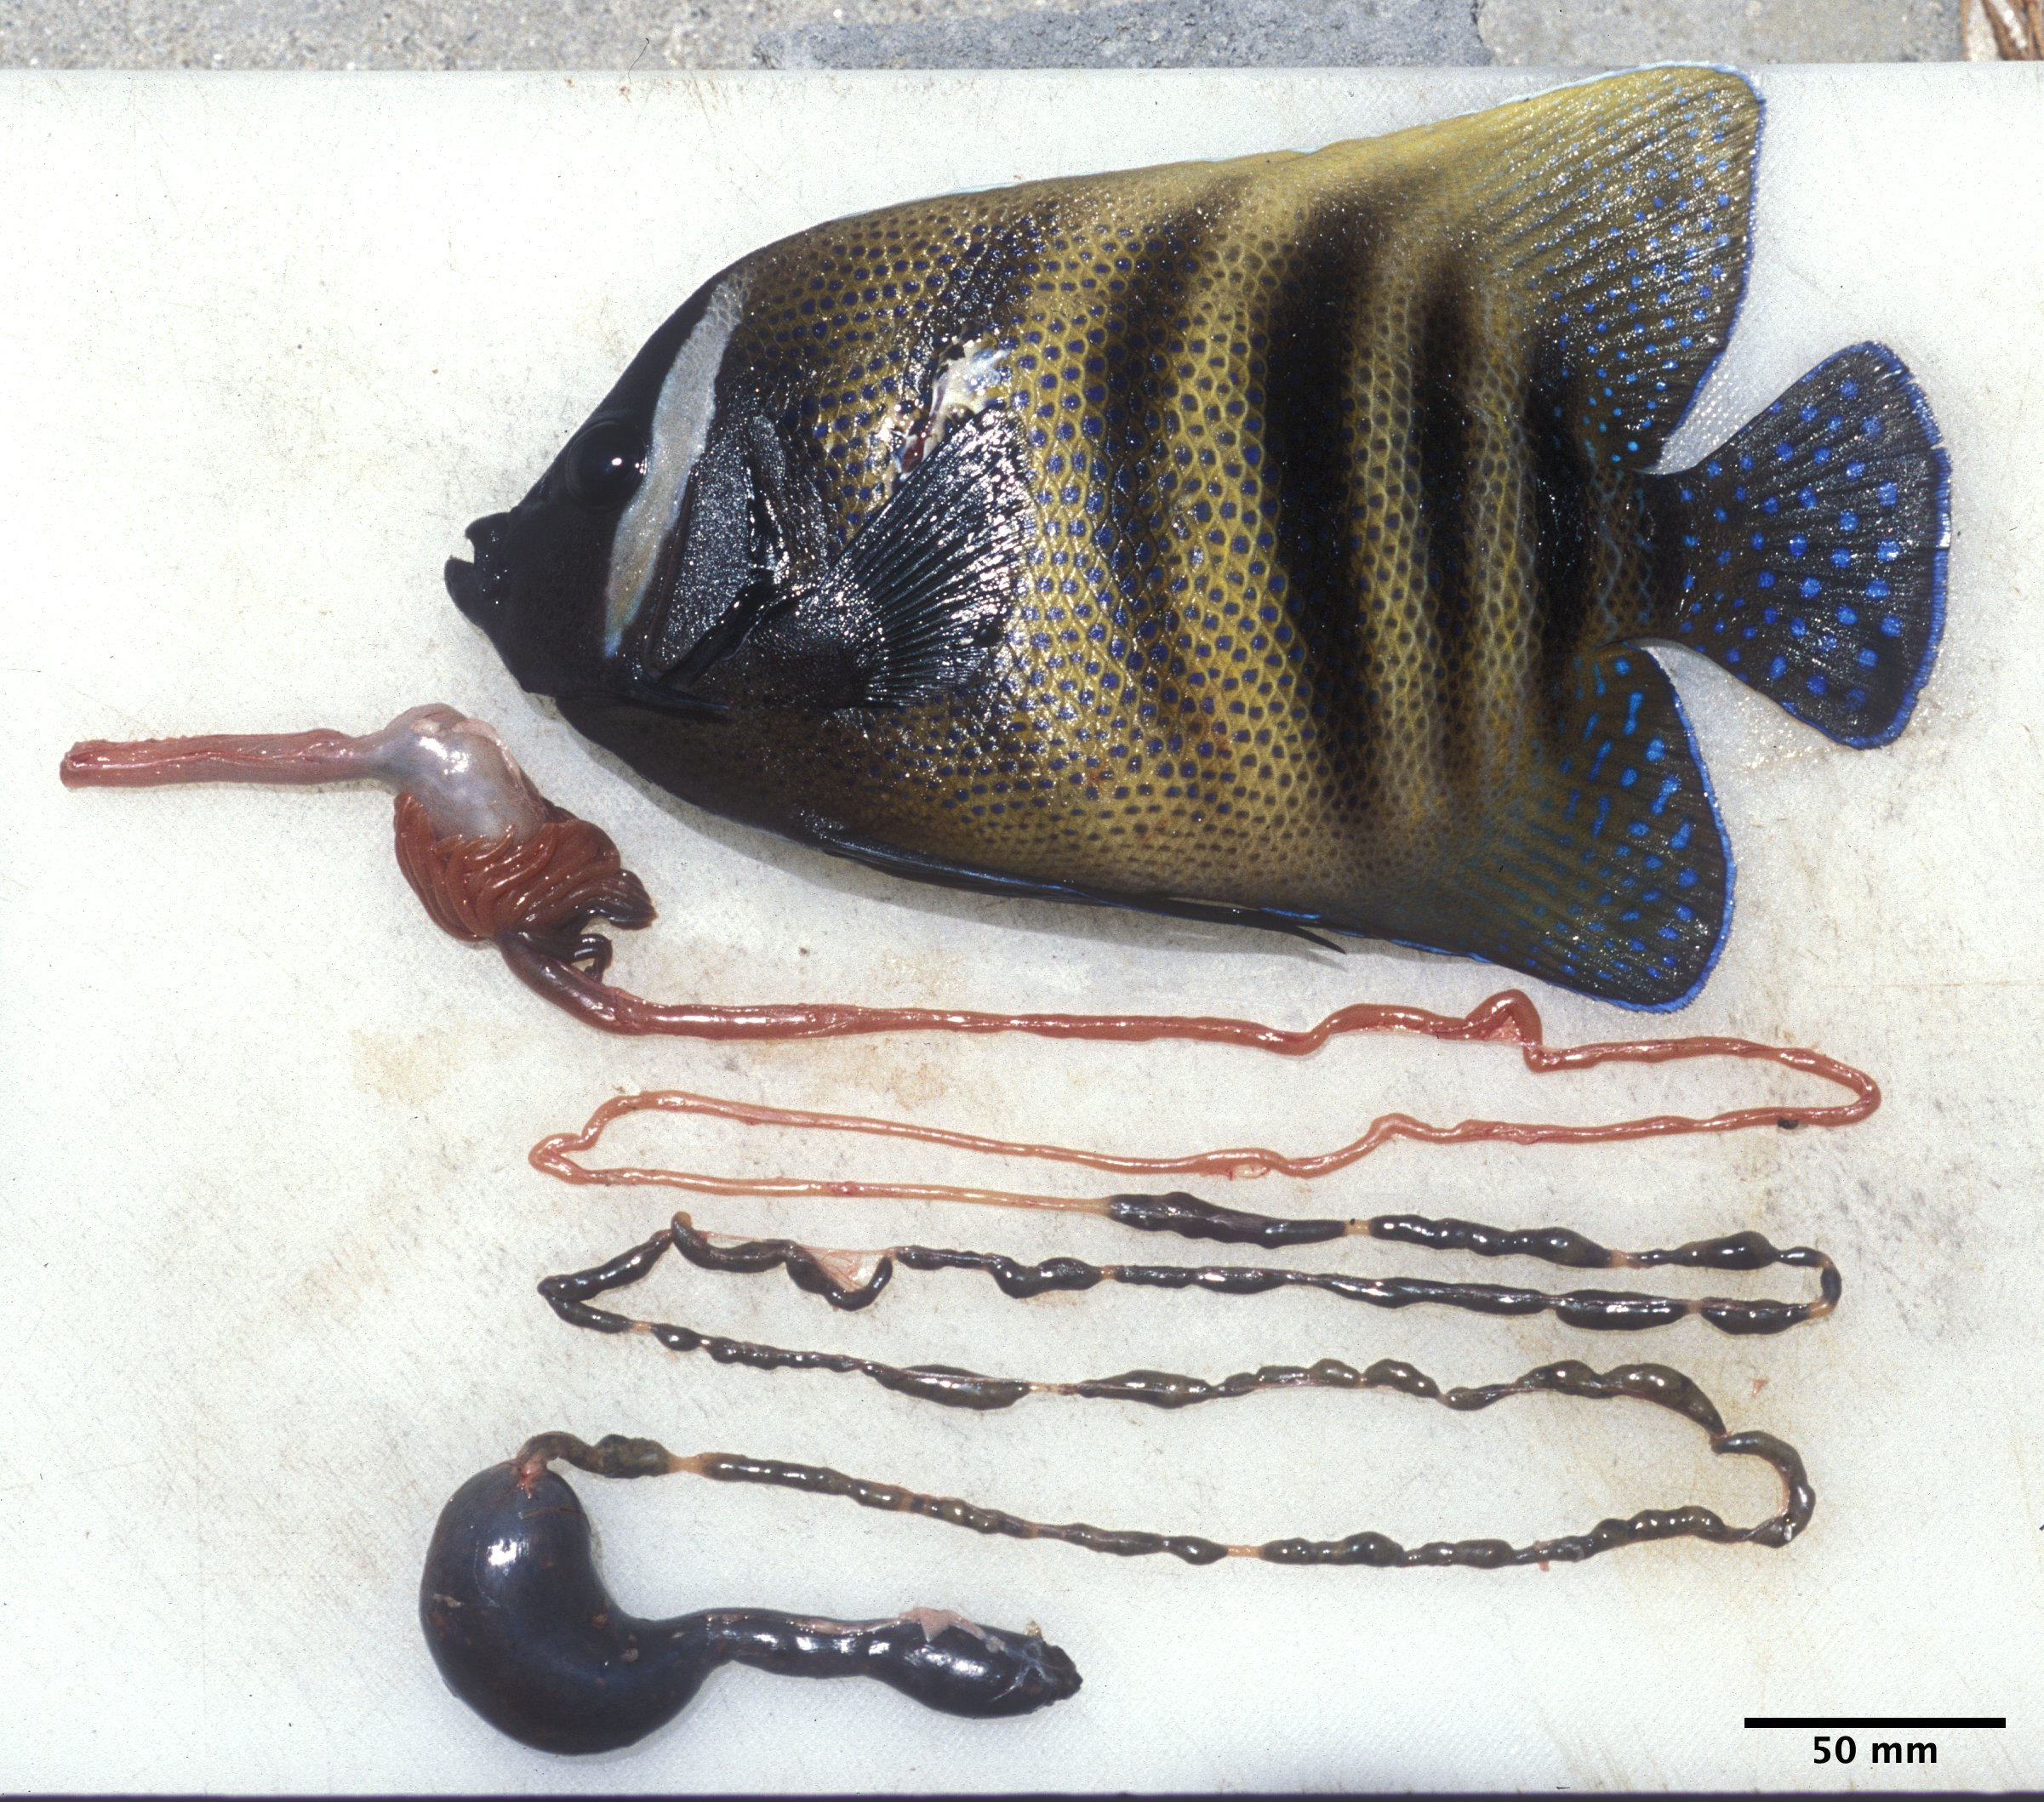
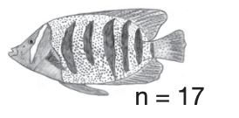
Sixbar Angelfish
Pomacanthus sexstriatus
Stomach
Pyloric caeca
Terminal sac

Slide 6

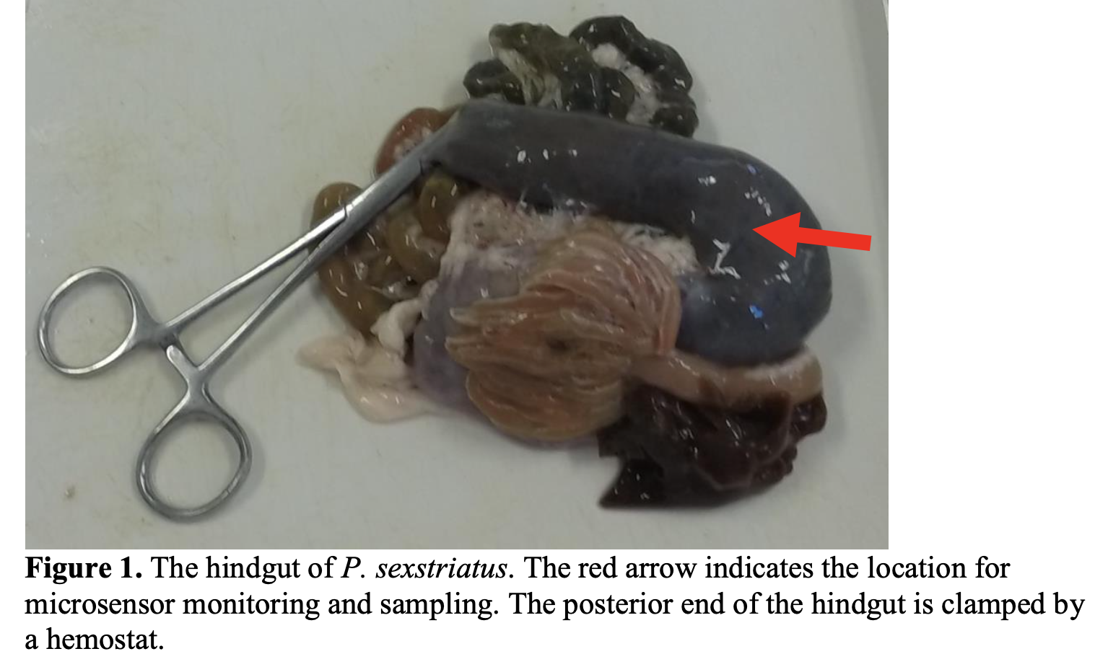
Methane/ Sulfide/ Hydrogen
Research by Francine Arroyo
Arroyo thesis Cornell University 2019

Slide 7
Methane/Sulfide/Hydrogen
Lactate
Sugars
Acetate
Pyruvate
H⁺
H⁺
Hydrogen
Sulfate
H⁺
CO₂
Methane
Sulfide
Acetate

Slide 8
Warning: fish dissection

Slide 9
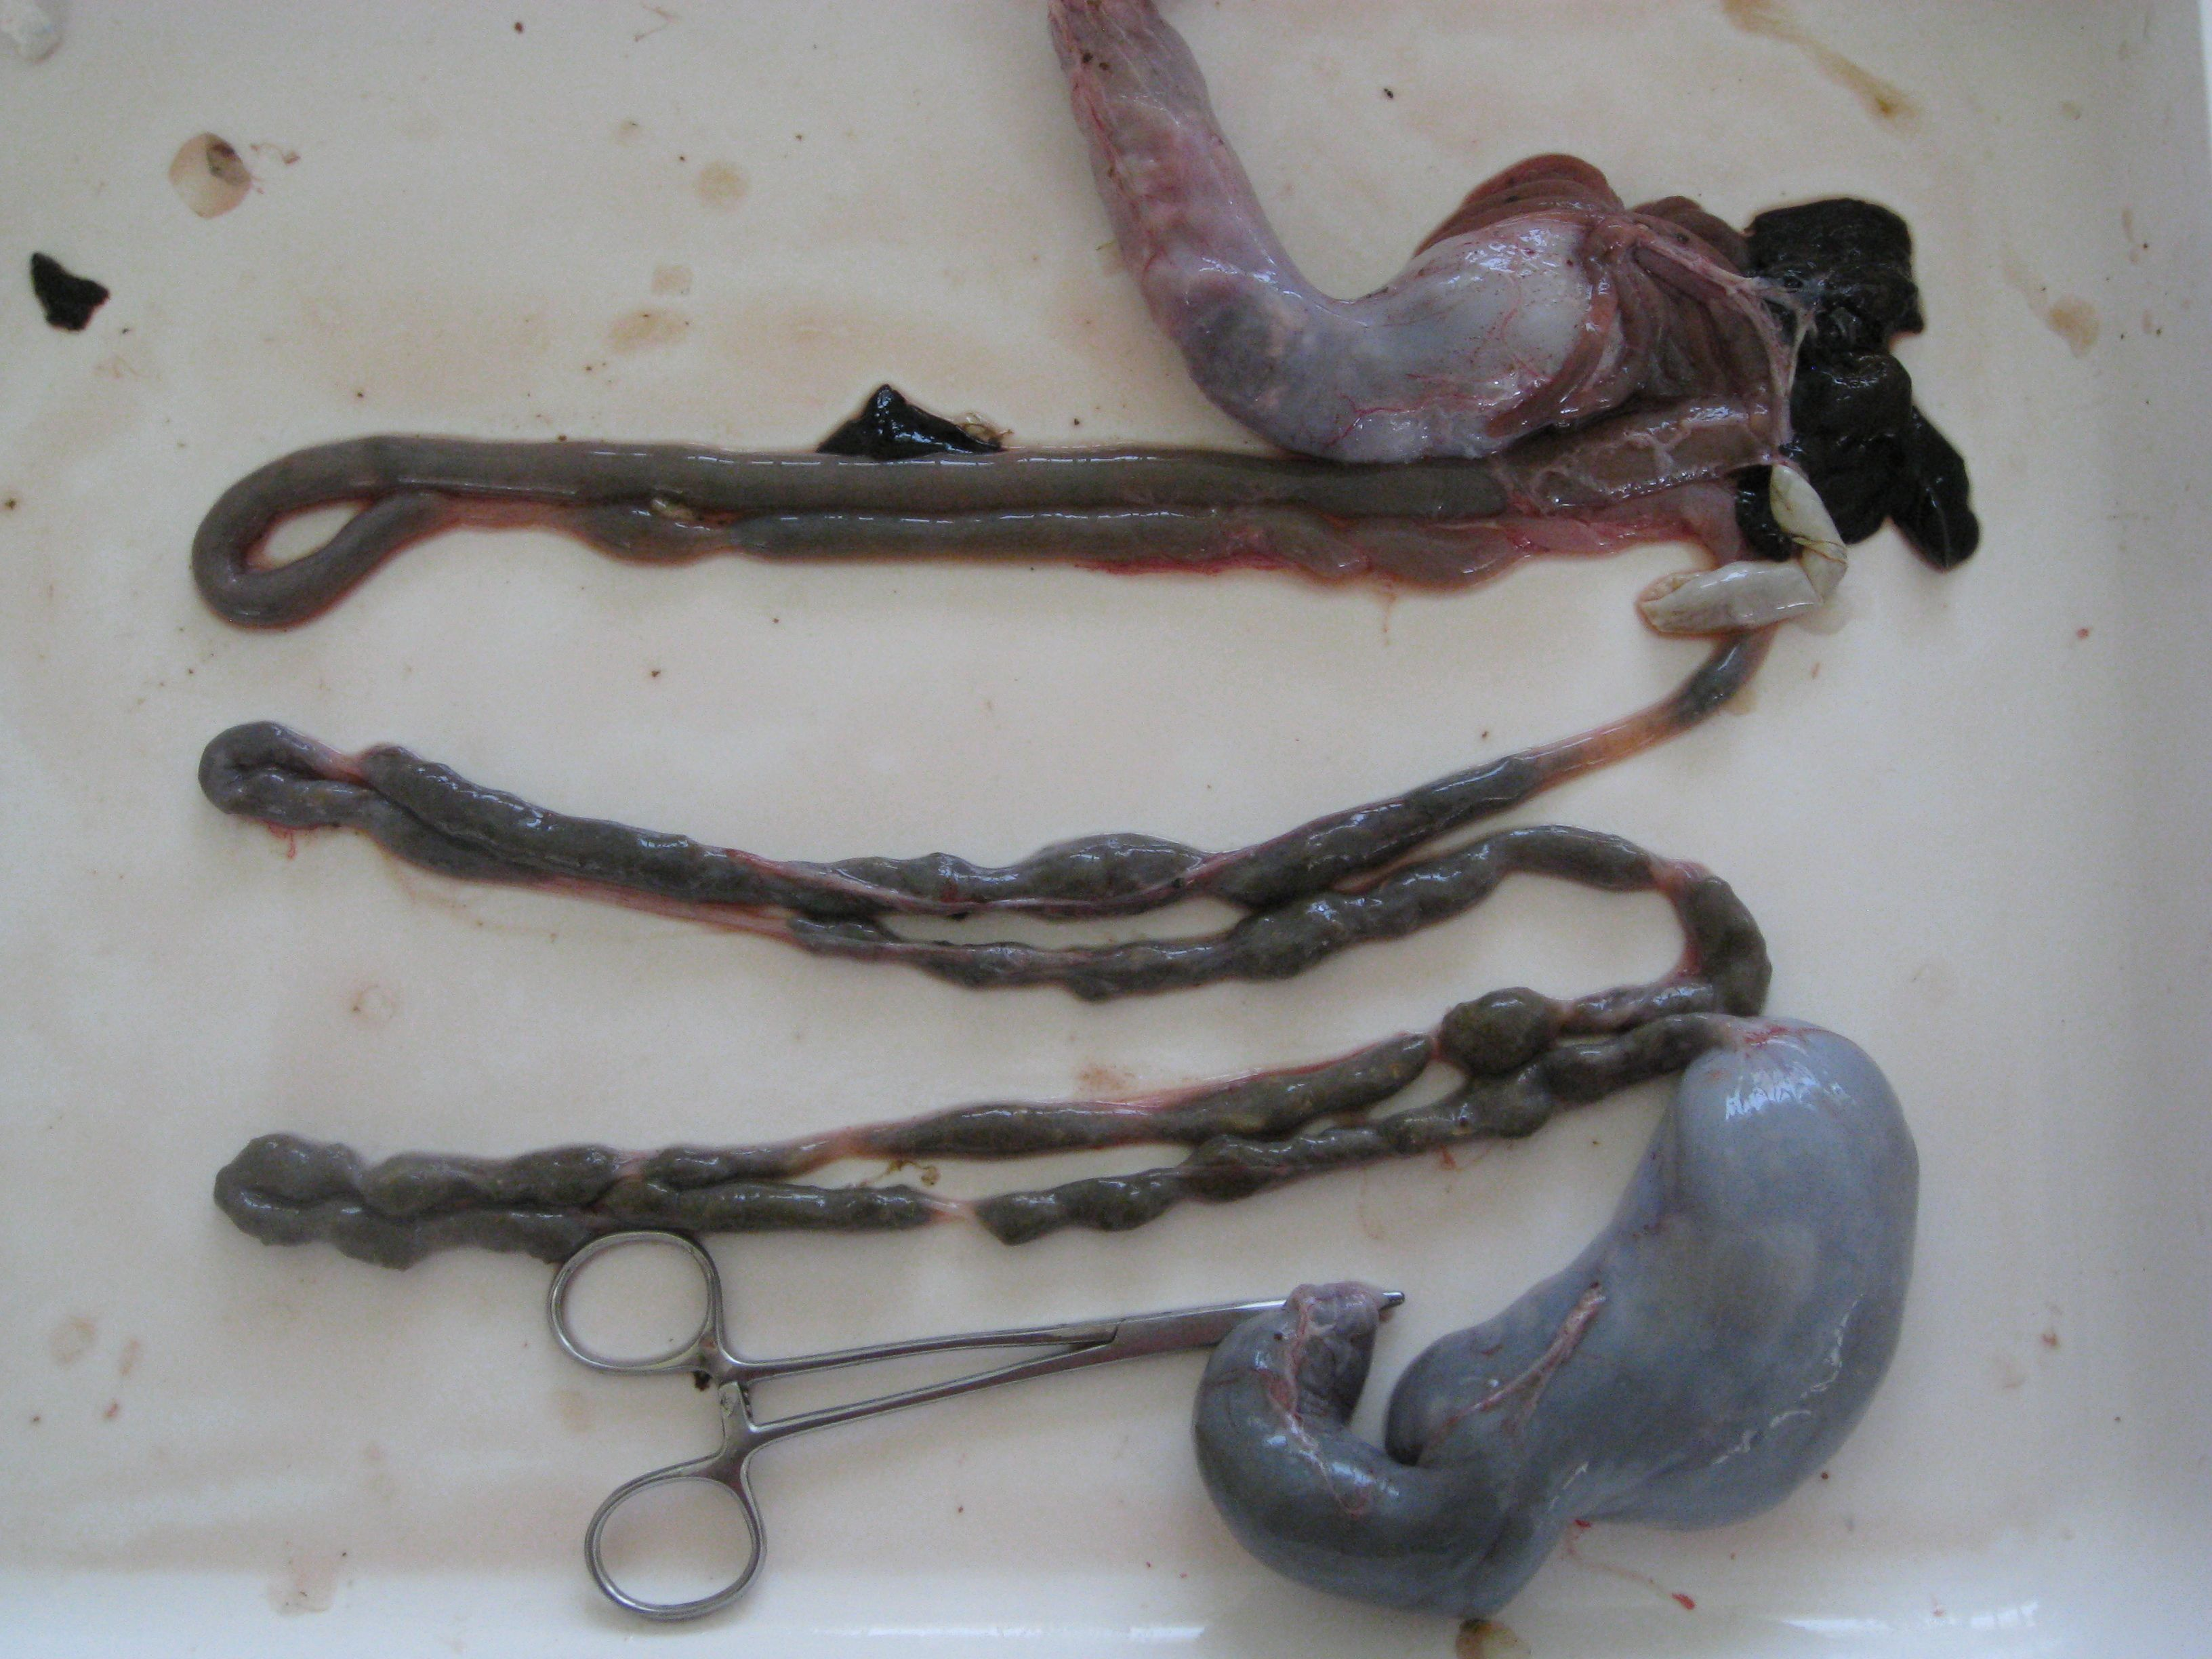
Stomach (segment I)
Segment II
Segment III
Segment IV
Segment V

Slide 10
Gut section IV versus Gut Section V
Differences in the microbiota make-up: Hindgut section (section V) versus just before the hindgut (section IV)
Presence of sulfate reducing bacteria?
Section IV versus section IV
Any methanogens detectable?
Hypothesis: we will find differences
Established community in the hindgut.
Differentiable from section IV.

Slide 11
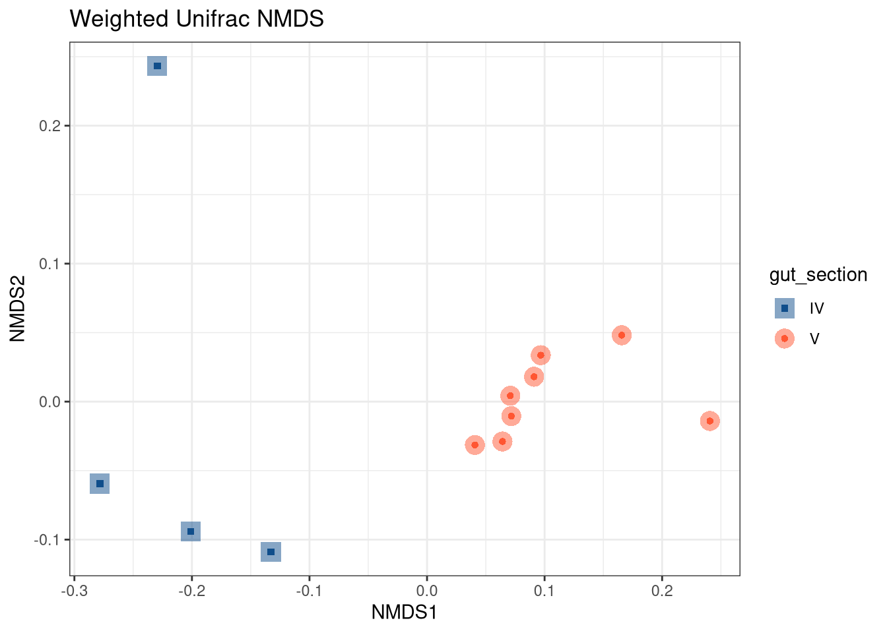
Gut section is a driver of microbial diversity
Stress = 2%
Permanova =
R² = 0.55059
F-stat = 12.251
p = 0.004 ***
BetaDispR =
not significant
F-stat = 1.5508
p = 0.233

Slide 12
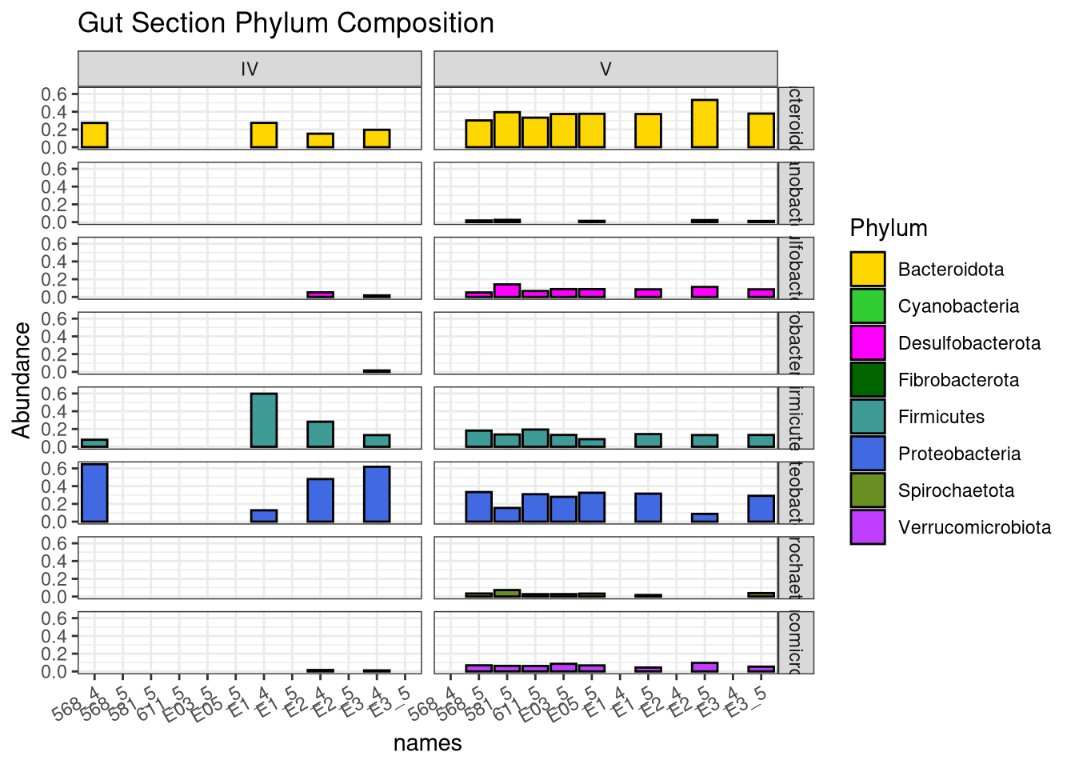
Microbiota change along GI tract

Slide 13
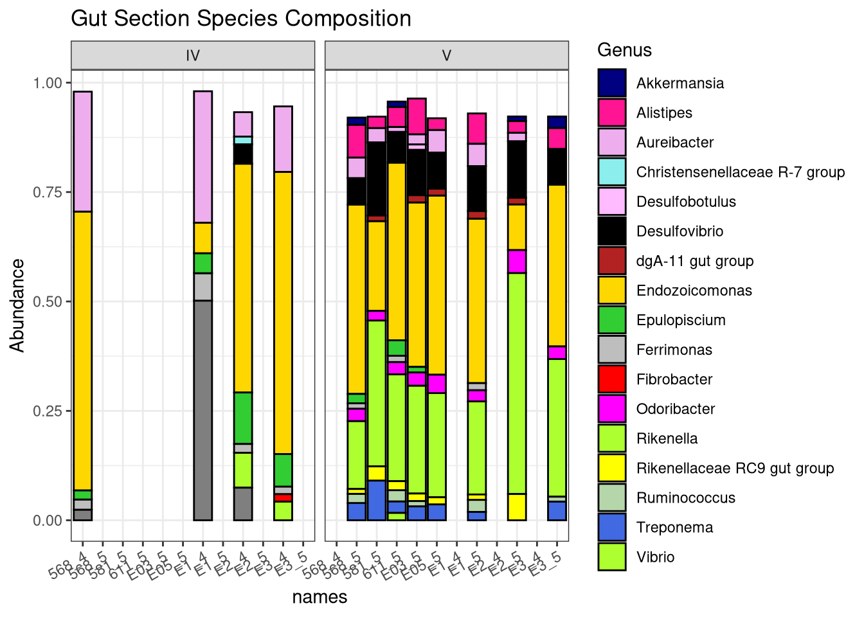
Species level shows differences in relative abundance

